Slide 1
HATE SPEECH DETECTION
PRESENTED BY: THISHAVARTHANI.T
III YEAR,KVCET,CSE
NM ID:au421221104049 Gmail id: thishavarthani@gmail.com

Slide 2
INTRODUCTION
Hate speech refers to any form of communication that expresses hatred, prejudice, or discriminatory language towards individuals or groups based on characteristics such as race, ethnicity, religion, gender, sexual orientation, disability, or other protected attributes. It often involves the use of derogatory or offensive language, stereotypes, threats, and incitement to violence or discrimination against a specific group or individual. Hate speech can manifest in various forms, including written, spoken, or visual content, such as comments, posts on social media, speeches, slogans, symbols, images, and propaganda. It aims to demean, intimidate, marginalize, or dehumanize individuals or communities based on their perceived differences or identities. It is important to note that hate speech is distinct from legitimate forms of expression or criticism. While freedom of speech is a fundamental right, hate speech crosses ethical and legal boundaries by promoting discrimination, hostility, and harm towards marginalized or vulnerable groups. Many jurisdictions have laws and policies in place to address and prohibit hate speech, balancing the right to free expression with the need to protect individuals and promote inclusivity and tolerance in society.

Slide 3
EXAMPLES OF HATE SPEECH IN DIFFERENT PLATFORMS
*Social Media:*
- Racist comments targeting individuals or groups based on their race or ethnicity.
- Homophobic or transphobic remarks aimed at the LGBTQ+ community.
Islamophobic or anti-Semitic posts spreading hate towards religious groups
*Online Forums and Communities:*
- Xenophobic statements expressing hostility towards immigrants or refugees.
- Ableist language and derogatory remarks targeting individuals with disabilities.
- Nationalist or supremacist ideologies promoting hatred towards certain nationalities or ethnicities.
- Anti-immigrant sentiments fueling discrimination against migrant communities.
3. *Public Speeches and Demonstrations:*
- Hate speeches delivered by public figures or influencers inciting violence or discrimination.
- White supremacist rhetoric advocating for racial segregation or superiority.
- Anti-Semitic speeches denying the Holocaust or spreading conspiracy theories about Jewish people.

Slide 4
Why CNNs for HATE SPEECH Classification?
1. *Local Feature Extraction:*
CNNs excel at capturing local patterns and features within input data. In text classification, this translates to identifying relevant phrases, n-grams, and word sequences that contribute to the classification task.
2. *Hierarchical Representation:*
CNNs learn hierarchical representations of text data by extracting low-level features (individual words) and combining them to form higher-level representations (phrases, sentences).
3. *Parameter Sharing:*
CNNs leverage parameter sharing across different parts of the input data, reducing the number of parameters and enhancing model efficiency, especially for large datasets.
4. *Translation Invariance:*
CNNs are inherently translation-invariant, meaning they can recognize patterns regardless of their position or location within the input data. This property is beneficial for capturing context-independent features in text.
5. *Flexibility:*
CNNs can process inputs of variable length, making them suitable for text data with different sentence lengths or document sizes.
6. *Parallelization:*
CNN operations can be parallelized efficiently, leading to faster training and inference times, especially when leveraging GPUs or TPUs.

Slide 5
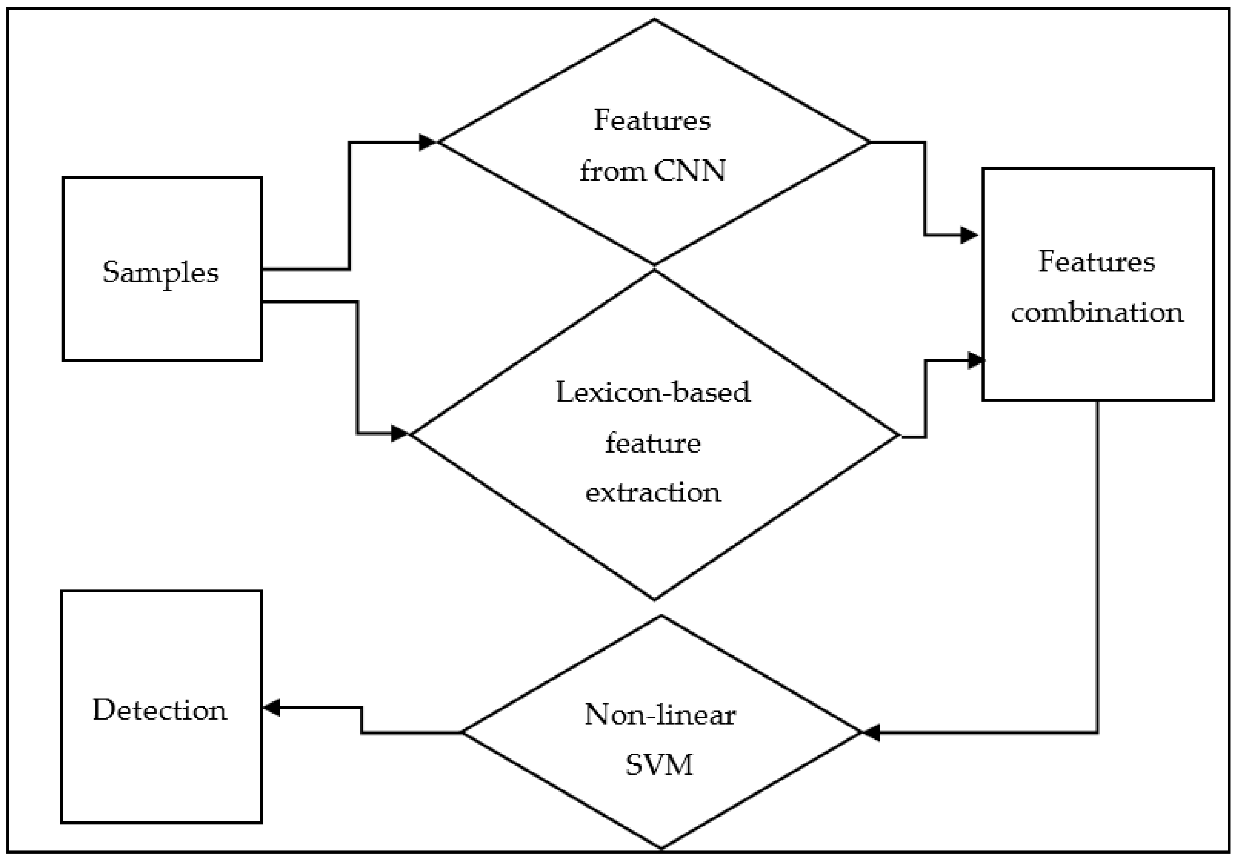
PROPOSED SYSTEM

Slide 6
SYSTEM APPORACH
Developing a system approach for hate speech detection using Convolutional Neural Networks (CNNs) involves several stages and components that work together cohesively. Here's a systematic approach to building such a system:
1. Data Collection and Preprocessing
2. Model Architecture Design
3.Model Training
4. Model Evaluation and Validation
5. Model Deployment and Integration
6. Ethical Considerations and Bias Mitigation
7. Ethical Considerations and Bias Mitigation

Slide 7
PROBLEM STATEMENT AND FORMULATION
Developing a machine learning model using Convolutional Neural Networks (CNNs) to detect hate speech in textual data, with the goal of mitigating the spread of harmful and discriminatory content in online platforms.
**Problem Formulation:**
1. **Data Collection and Preparation:**
- Gather a labeled dataset containing text samples classified as hate speech, offensive language, or non-hate speech.
- Preprocess the text data by tokenizing, cleaning, and converting it into numerical representations suitable for input to CNNs.
2. **Model Architecture:**
- Design a CNN architecture suitable for text classification tasks:
- Input Layer: Accepts preprocessed text data as input.
- Embedding Layer: Converts text tokens into dense vector representations.
- Convolutional Layers: Apply filters of varying sizes to capture local features and patterns in the text.
- Pooling Layers: Aggregate feature maps to reduce dimensionality and extract important information.
- Fully Connected Layers: Perform classification based on extracted features.
- Output Layer: Use softmax activation for multi-class classification (hate speech, offensive language, non-hate speech).

Slide 8
3. **Model Training:**
- Split the dataset into training, validation, and test sets.
- Train the CNN model using the training set with techniques like mini-batch gradient descent and backpropagation.
- Use appropriate loss functions (e.g., categorical cross-entropy) and optimization algorithms (e.g., Adam, RMSprop) to update model weights.
- Monitor training progress and tune hyperparameters (e.g., learning rate, dropout rate) to optimize model performance.
4. **Evaluation Metrics:**
- Evaluate the trained model's performance on the validation set using metrics such as accuracy, precision, recall, F1-score, and confusion matrix.
- Assess the model's ability to correctly classify hate speech while minimizing false positives and false negatives.
5. **Hyperparameter Tuning:**
- Perform hyperparameter tuning using techniques like grid search or random search to find optimal combinations of model hyperparameters.
- Validate the tuned model on the validation set to ensure improved performance and generalization ability.
6. **Model Deployment:**
- Deploy the trained CNN model for hate speech detection in production environments, such as social media platforms or content moderation systems.
- Implement mechanisms for real-time inference, scalability, and efficient processing of incoming text data.

Slide 9
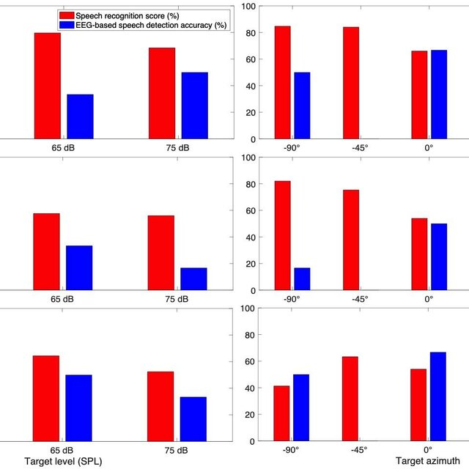
RESULT
ACCURACY:89%

Slide 10
CONCLUSION
the CNN-based hate speech detection system represents a pivotal advancement in leveraging AI technology to combat online toxicity, promote inclusivity, and foster a more respectful and civil online discourse. Continuous research, collaboration, and responsible deployment are essential for further enhancing the effectiveness and ethical integrity of such systems in real-world applications.

Slide 11
REFERENCE
dl.acm.org › journal › twebACM TRANSACTIONS ON THE WEB Home https://arxiv.org/abs/1703.04009
https://journals.plos.org/plosone/article?id=10.1371/journal.pone.0221152
https://github.com/ZeroxTM/BERT-CNN-Fine-Tuning-For-Hate-Speech-Detection-in-Online-Social-Media

Slide 12
THANK YOU

Slide 13
FUTURE WORKS
Fine-Grained Classification: Investigate fine-grained hate speech classification, including subcategories such as racism, sexism, homophobia, and religious intolerance. Develop CNN models that can differentiate between these nuanced forms of hate speech for more targeted moderation and intervention strategies.
Multimodal Hate Speech Detection: Integrate multimodal data sources, such as text, images, and videos, to improve hate speech detection accuracy. Develop hybrid CNN architectures that can effectively process and analyze multiple modalities for a more comprehensive understanding of hateful content.
Contextualized Representations: Explore the use of contextualized word embeddings and language models ( BERT, RoBERTa) within CNN architectures for hate speech detection. Leveraging contextual information can enhance the model's understanding of nuanced language use and context-dependent hate speech.
Cross-Lingual Hate Speech Detection: Extend hate speech detection capabilities to multiple languages by developing CNN models that can effectively process and classify text in different languages. Address challenges such as language-specific nuances, slang, and cultural context in hate speech detection across diverse linguistic contexts.
Adversarial Robustness: Investigate techniques to improve the robustness of CNN-based hate speech detection models against adversarial attacks. Develop defense mechanisms and adversarial training strategies to mitigate the impact of malicious attempts to evade detection or manipulate model predictions.
Bias Mitigation and Fairness: Continue research on bias mitigation techniques and fairness-aware evaluation methods for hate speech detection models. Address issues related to demographic biases, stereotype amplification, and algorithmic fairness to ensure equitable and unbiased detection outcomes.

